Slide 1
Lecture 2
CS494 – Information System Audit and Control
17th Feb 2024

Slide 2
Google Classroom CODE
veowk7s

Slide 3

Recap
Chapter 1 - Audit Planning and Execution
Audit Charter
Business Process
Risk and Risk Assessment
Controls
Qs – Its your first day at an FMCG as an IS auditor.. What would you do ?

Slide 4
Information Systems Auditing Process
This chapter can be divided into two sections:
Audit Planning
Audit Execution

Slide 5

Section 1 – Audit Planning
The content of an audit charter
Audit planning
Business process applications and controls
Types of controls
Risk-based audit planning
Types of audit and assessment
Qs – Your first day as an IS auditor in an FMCG. You have been given an audit plan…

Slide 6
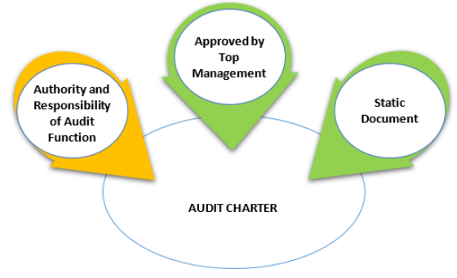
Audit Charter
An audit charter is a formal document defining the internal audit's objective, authority, and responsibility. Approved by BOD or Sr. Mgmt.
The audit charter covers the entire scope of audit activities.
If the audit is outsourced, then audit charter is incorporated in an engagement letter.

Slide 7

Terminologies to know for audit planning
Audit universe: An inventory of all the functions/ processes/units under the organization.
Qualitative risk assessment: In a qualitative risk assessment, risk is assessed using qualitative parameters such as high, medium, and low.
Quantitative risk assessment: In a quantitative risk assessment, risk is assessed using numerical parameters and is quantified.
Risk factors: Factors that have an impact on risk. The presence of those factors increases the risk, whereas the absence of those factors decreases the risk.

Slide 8
Audit Planning – Initial Stage
The objectives of the audit
The scope of the audit
The periodicity of the audit
The members of the audit team
The method of audit

Slide 9
Benefits of Audit Planning
It helps the auditor to focus on high-risk areas.
It helps in the identification of resource requirements to conduct the audit.
It helps to estimate the budget for the audit.
It helps to carry out audit work in a defined structure, which ultimately benefits the auditor as well as the auditee units.

Slide 10
Audit planning process steps (read yourself)
Gain an understanding of the organization’s mission, objectives, purpose and processes, which include information and processing requirements such as availability, integrity, security, and business technology and information confidentiality.
Gain an understanding of the organization’s governance structure and practices related to the audit objectives.
Understand changes in the business environment of the auditee.
Review prior work papers.
Identify stated contents such as policies, standards and required guidelines, procedures, and organization structure.
Perform a risk analysis to help in designing the audit plan.
Set the audit scope and audit objectives.
Develop the audit approach or audit strategy.
Assign personnel resources to the audit.
Address engagement logistics.

Slide 11

Selection of Audit processes
Create an audit universe.
Each business process may undergo a qualitative or quantitative risk assessment by evaluating the risk in respect to relevant risk factors. i.e conduct a risk assessment
In easier words, determine how meaningful is this process to the company?
This risk assessment helps to determine frequency of audits. E.g …?

Slide 12
Business process applications and controls
Working knowledge of the business environment and business objectives is required to plan a risk-based audit.
To effectively audit business application systems, an IS auditor is required to gain a thorough understanding of the system under the scope of the audit.

Slide 13
Common business applications & Risks
POS Systems
Debit / Credit card transactions happen.
Data captured at time of sale.
Risks
Skimming
Disclosure of PINs

Slide 14
As in IS auditor of POS systems..
The IS auditor's objectives are as follows:
To determine that data used for authentication (PIN/CVV) is not stored in the local POS system.
To determine that the cardholder's data (either at rest or in transit) is encrypted.

Slide 15
Common business applications & Risks
E-commerce Applications
Single Tier
Two Tier
Multi Tier
E-commerce Risks
Confidentiality of customer data
Data Integrity due to unauthorized alterations
System unavailability
Repudiation of transaction

Slide 16
As in IS auditor of Ecommerce apps..
Review the overall security architecture related to firewalls, encryption, networks, PKI to ensure confidentiality, integrity, availability, and the non- repudiation of e-commerce transactions.
Review the process of log capturing and monitoring for e-commerce transactions.
Review the incident management process.
Review the effectiveness of the controls implemented for privacy laws.
Review anti-malware controls.
Review business continuity arrangements.

Slide 17
Controls
A control is a process that is used to safeguard the assets of an organization.
To mitigate the risks faced by an organization.
Assets can include systems, data, people, hardware, or the reputation of the organization.
Internal controls are implemented through policies, procedures, and organizational structures to address risks.

Slide 18
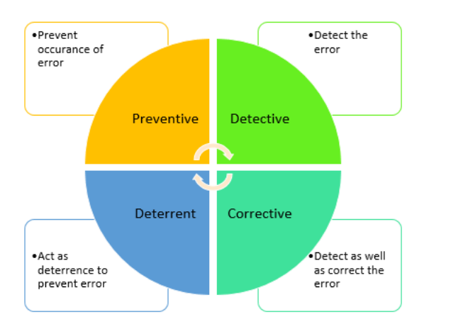
Types of Controls

Slide 19
Examples of Preventive Controls
Lock on the door to prevent someone from entering.
The use of qualified personnel
The segregation of duties
The use of SOPs to prevent errors
Transaction authorization procedures
Access control procedures
Firewalls
Physical barriers

Slide 20
Examples of Detective Controls
Motion sensor in room
Internal audits and other reviews
Log monitoring
Checkpoints in production jobs
Echo controls in telecommunications
Error messages over tape labels
Variance analysis

Slide 21
Examples of Corrective Controls
Guard inside to say “excuse me sir your place is outside”
Business continuity planning
Disaster recovery planning
Incident response planning
Backup procedures

Slide 22
Examples of Deterrent Controls
CCTV cameras or "under surveillance" signs
Warning signs
Then what is the difference between a preventive and deterrent control?
Locked door is a preventive control. Intruder can't go through the door. There is no other choice.
Having a no-entry sign still gives the intruder a choice.
How does one decide which one to implement?

Slide 23
Compensating Controls
Compensating controls are alternate measures that are employed to ensure that weaknesses in a system are not exploited.
For example, in small organizations, the segregation of duties may not always be feasible. In such cases, compensatory controls such as reviews of logs should be implemented.
A single user has access to and performs the tasks of accepting cash payments and recording the payments. Due to the nature of the business, and for efficiency, the same user performs both tasks. To prevent fraud, oversight is required. So, we need a compensating control – for example, we may specify that a second user must perform a reconciliation, reviewing the cash against the recorded transactions.

Slide 24
Control Objectives
A control objective is a reason why a control is implemented.
Control Measures
Control measures are implemented to achieve control objectives. Control measures are activities that are taken to prevent, eliminate, or minimize the risk of threat occurrence.

Slide 25
Case: ATM machine
Review physical security to prevent introduction of malware.
Review measures to establish proper customer identification and maintenance of their confidentiality.
Review file maintenance and retention system to trace transactions
Review daily reconciliation of ATM transactions including:
Review SoD in the opening of the ATM and recount of deposit.
Review the procedures made for the retained cards.
Review encryption key change management procedures.
Review physical security measures to ensure security of the ATM and the money contained in the ATM.
Review the ATM card slot, keypad and enclosure to prevent skimming of card data and capture of PIN during entry

